Slide 1
Automatic electrostatic discharge tester.
Viktor Hugo Hersom From

Slide 2
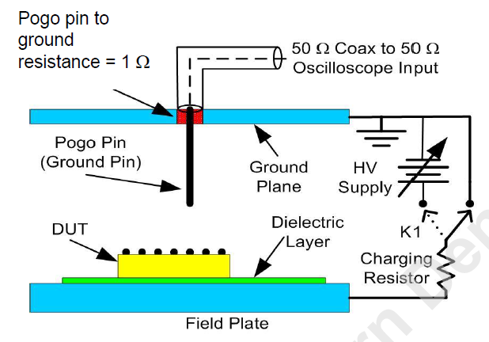
What is the problem?
Electrostatic discharge (ESD) events.
39 – 48% of all product failures in industry related to ESD.
JS-002-2018 test standard.
Used to measure discharge from a device.
Time-consuming to complete.
The most important parts are:
Pogo pin
Ground plane.
Device Under Test (DUT)
Oscilloscope
Notes:
Electrostatic discharge is a phenomenom, where a voltage potential is built up across two

Slide 3
What is electrostatic discharge?
Triboelectrification.
Electrons are transferred between materials when there is contact.
Charges build up on the two materials.
Electrostatic discharge.
The material between the two charges breaks down.
A conducting path is formed.
Charges move from one component to another.

Slide 4
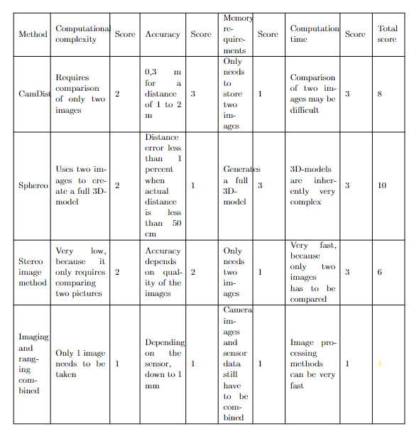
Different concepts for the solution.
CamDist
Sphereo
Stereo image method.
Imaging and ranging combined.

Slide 5
CamDist
Two pictures:
One picture taken at first.
Camera moves a set distance forward.
Second picture is taken.
Difference between the images gives the distance to the object.

Slide 6
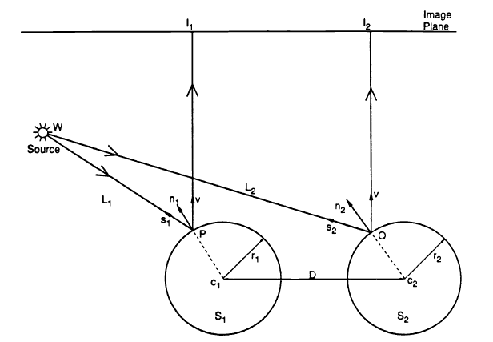
Sphereo
Two balls used to generate two images.
Two balls separated by a known distance D.
Reflection forms two separate images.
Triangulation performed on the two images to generate a 3D-map.
Figure source: Shree K. Nayar, "Sphereo: Determining Depth Using Two Specular Spheres And A Single Camera," Proc. SPIE 1005, Optics, Illumination, and Image
Sensing for Machine Vision III, (7 March 1989); doi: 10.1117/12.949051

Slide 7
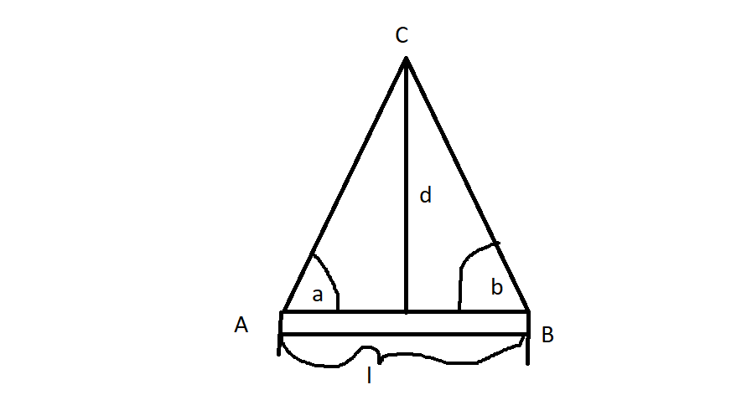
Triangulation.
Given:
Point A.
Point B.
Angle at point A.
Angle at point B.
Distance between points A and B
Find:
Distance to point C.
Method:
tan(a) = d/(l/2)
Find the angle a = tan^-1(d/(l/2))
Notes:
Triangulation works in the way that if you have two points A and B, separated by a known distance L, then you can find the distance to a third point C by the use of trigonometry.

Slide 8
Triangulation (continued)
Given a point on an image plane, it is then possible to determine the angle from the camera to the point on the image plane.

Slide 9
Stereoscopic imaging.
Using the difference between two images to determine depth of a scene.
Fundamental matrix F.
Essential matrix E.
Rotation matrix R.
Rectified images.

Slide 10
Imaging and ranging combined
One camera used in combination with a range-finding sensor to determine position and range.
Methods for ranging:
LiDAR.
RADAR.

Slide 11
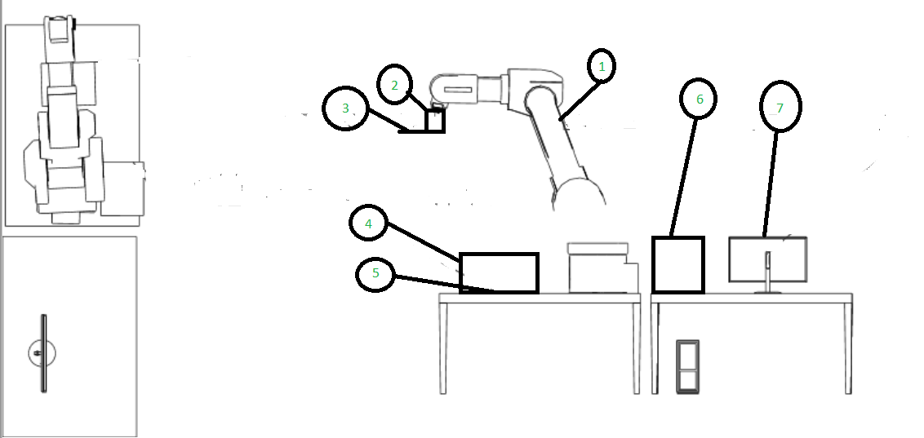
The concept.
A Kawasaki robot arm
A holder consisting of three parts:
Robot tool strut.
Ground plate.
Sensor mount.
A distance sensor and a camera.
A box designed to eliminate shadows.
The Device Under Test (DUT)
An oscilloscope.
A computer used to control everything.

Slide 12
The holder.
The holder is designed to accommodate:
A ground plate.
10 1-ohm resistors.
A pogo pin.
A distance sensor and camera.
The holder consists of three parts:
A robot tool strut.
A ground plate.
A sensor mount.

Slide 13
Hardware.
See3 Cam 130.
VL53L4CD distance sensor.
Force-sensitive resistor.
Oscilloscope.

Slide 14
See3 Cam 130

Slide 15
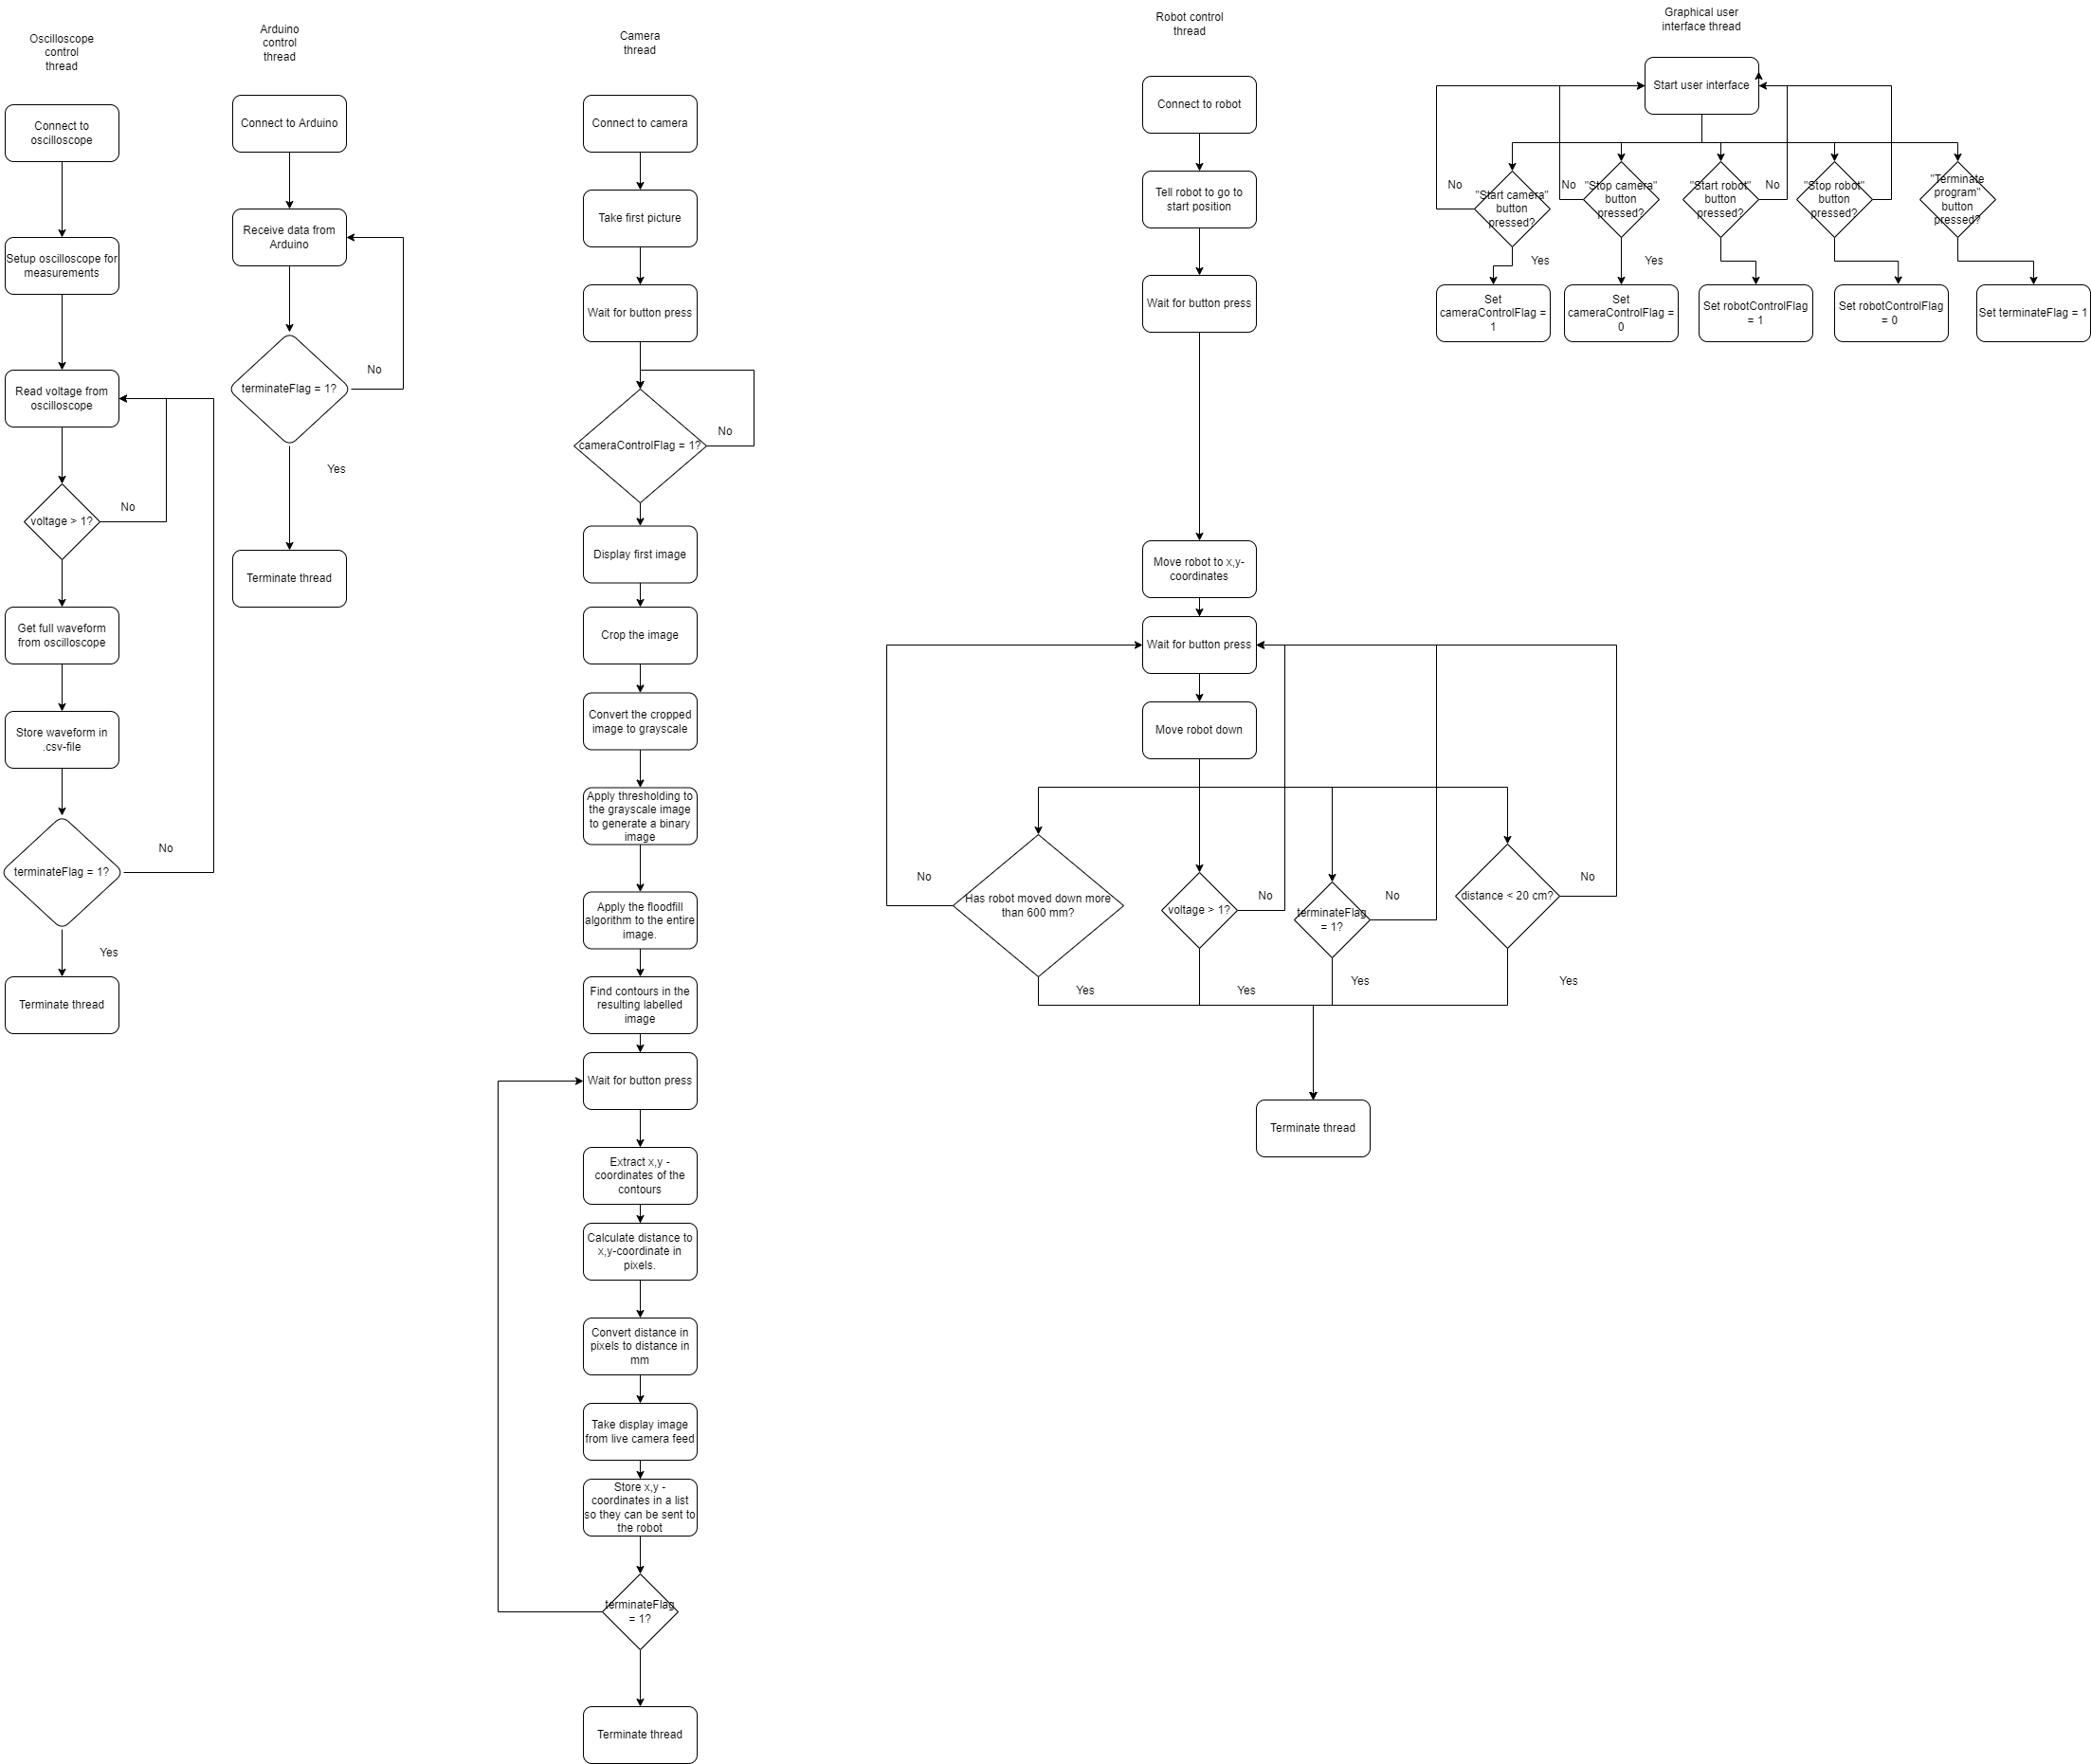
The software concept.
Five threads:
Oscilloscope.
Arduino.
Robot control.
Video.
Interface.
The most important threads are:
Video
Robot control

Slide 16
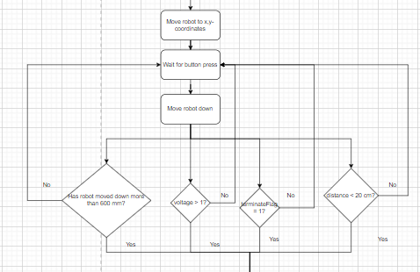
Robot control
Steps:
Move robot to x,y-coordinates.
Wait for button press.
Move robot down.
Stop the robot if:
Robot has moved down more than 600 mm.
The measured voltage is above 1 V.
TerminateFlag is set to 1.
The measured distance is below 20 mm.

Slide 17
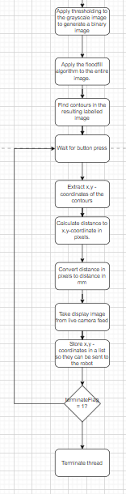
Video thread
Steps:
Generate a binary image.
Apply floodfill.
Find contours in the resulting image.
Wait for button input.
Extract x,y – coordinates.
Calculate distance to coordinates.
Convert distance to mm.
Send distance to robot.

Slide 18
Image processing
Grayscale.
Thresholding.
Finding contours.
Finding x,y-coordinates.

Slide 19
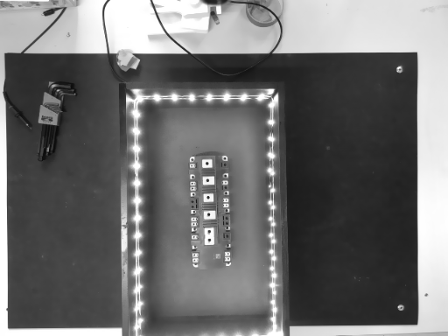
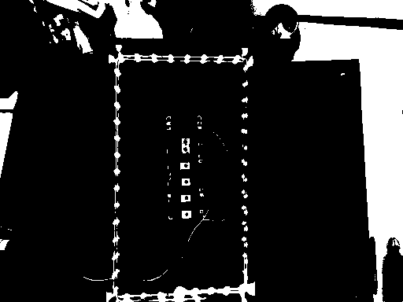
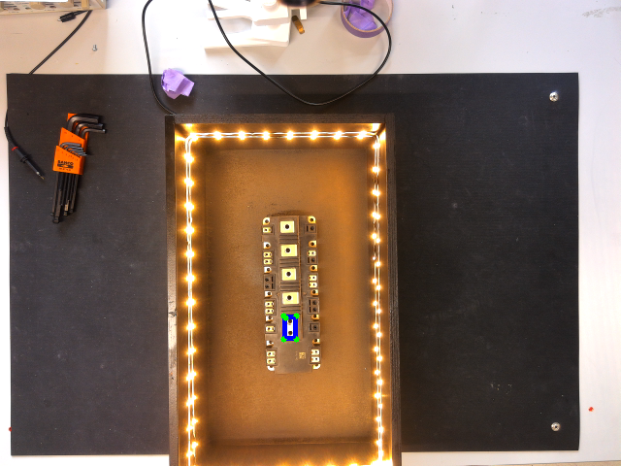
Image processing theory.
Grayscale:
Combine the three color channels into one channel.
Value then represents the intensity of light.
Thresholding:
Convert the grayscale image into a binary image.
If intensity is above a threshold value: 255.
If intensity is below a threshold value: 0.
Finding contours:
findContours()-function from OpenCV.
Extracting x,y-coordinates:
The boxPoints()-function from OpenCV.

Slide 20
Image segmentation
Possible methods:
Watershed.
K-means segmentation.
Color segmentation.
Contour segmentation.
Template matching.
Floodfill.

Slide 21
Watershed
Topographical map of the intensity.
Peaks and valleys.
Valleys are filled up.
Conflicts between labels give borders.

Slide 22
K-means segmentation
Pixels are sorted according to their values.
Each group of pixels gets a separate label.

Slide 23
Color segmentation
The image is converted to HSV color space.
Hue.
Saturation.
Value.
Target has color within a certain range.
Image can then be split into ranges.

Slide 24
Contour segmentation
Convert to grayscale.
Canny edge detection.
Second derivative of the gradient between pixels.
Find the zero crossing.
Collect the contours in a list.
OpenCV findContours().
Looks for connected components in the binary image.
Generate a mask based on the contours.
Apply the mask to the original image.

Slide 25
Template matching.
Two images:
New image.
Template image.
Identify a series of keypoints in the template image and the new image.
Compare the different keypoints and return the matches between the keypoints.

Slide 26
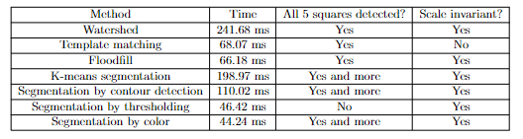
Comparison of the different methods

Slide 27
Floodfill.
How does it work?
Finding a seed point.
Visit the neighbouring pixels.
Mark them if they are unmarked.
When two neighbouring regions meet:
Note the conflict.
After the entire picture has been marked, resolve the conflict.

Slide 28
Experimental results.
Force-sensitive resistor.
Distance sensor.
Oscilloscope.

Slide 29
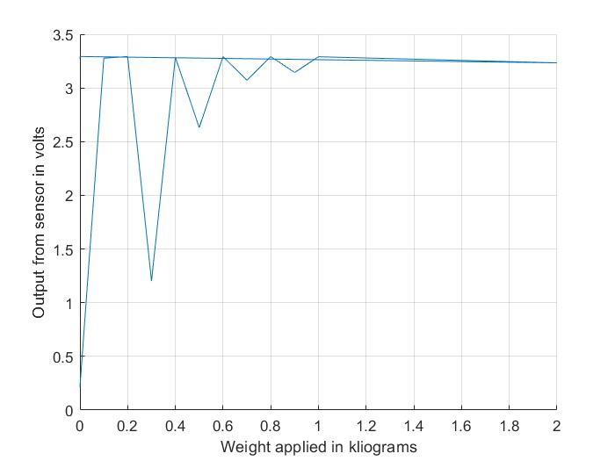
Test of force-sensitive resistor

Slide 30
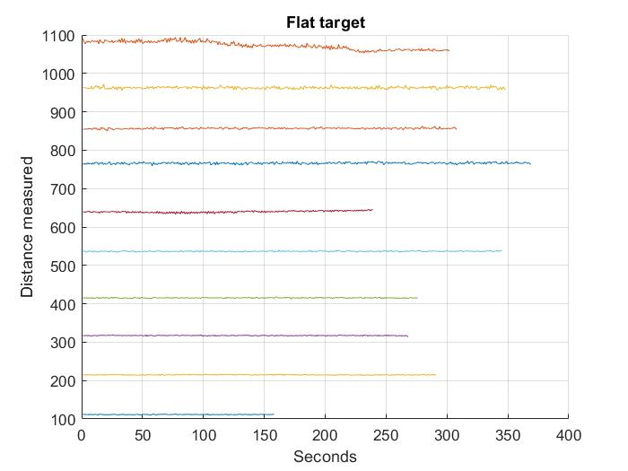
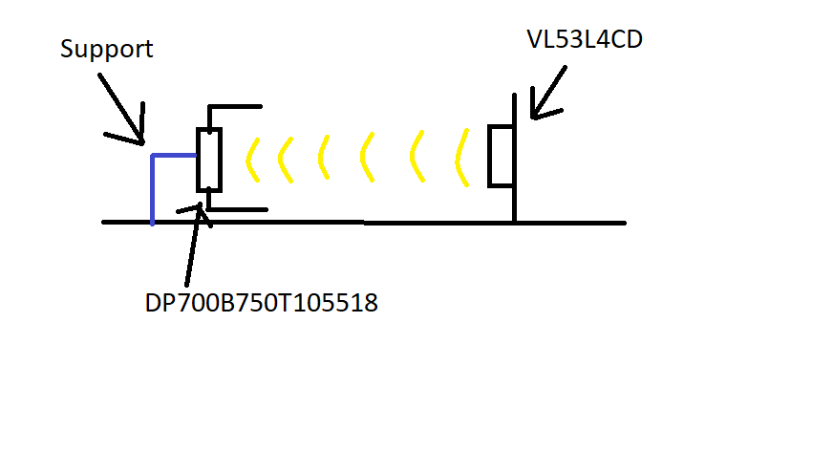
Test of VL53L4CD distance sensor.

Slide 31
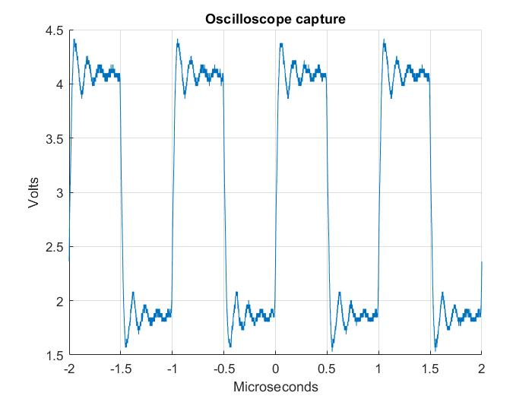
Test of oscilloscope capture.

Slide 32
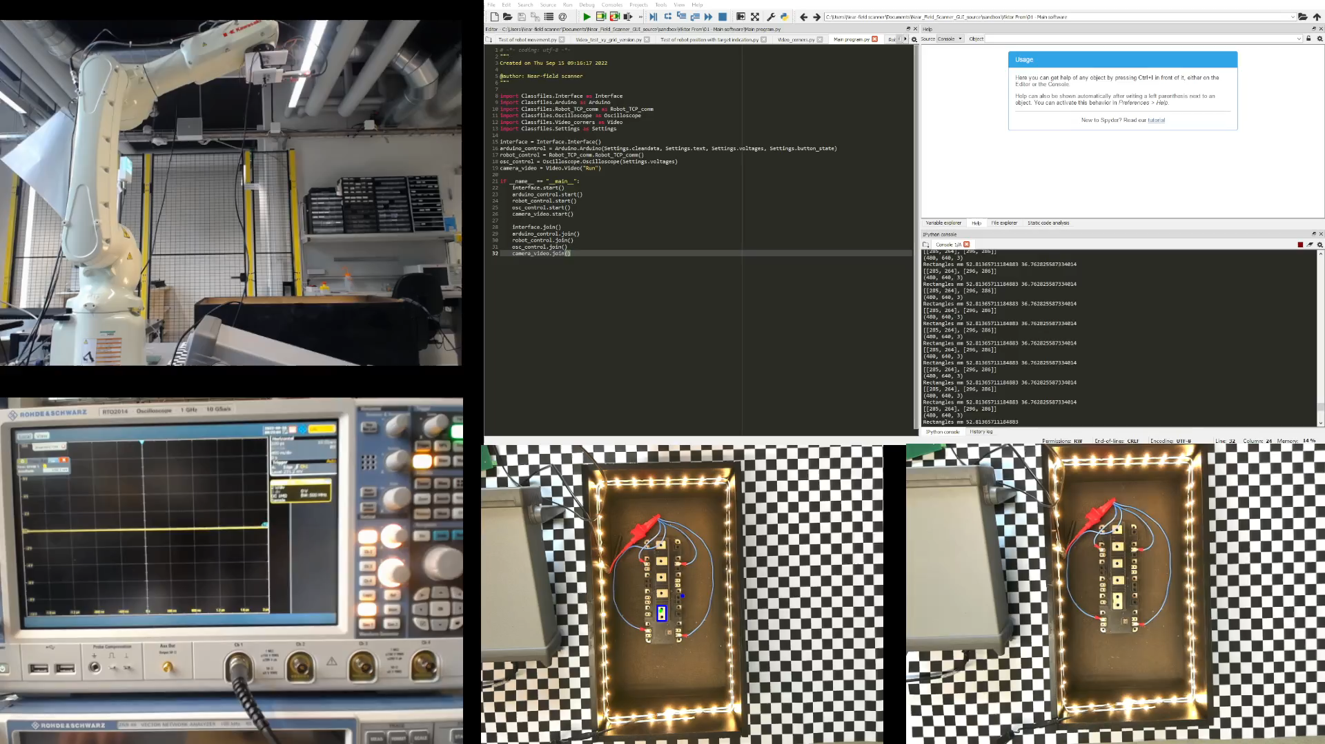
Acceptance test

Slide 33
Conclusion.
Design allows for one measurement to be taken on a charged unit.
Mechanical deisgn consists of three parts:
Robot tool strut.
Ground plate.
Sensor mount.

